Slide 1
Chordity
A project developed by Rex A. Herndon

Slide 2
Table of Contents
Overview
Application Preview
Curriculum Area Implementation/Understanding
Software Systems
Business Analytics
Cybersecurity and Networking
Data Mining and Management
Future Plans

Slide 3
Overview

Slide 4
What is it?
Chordity is a web based chat platform focused around connecting musicians and collaborating together to inspire and kickstart new tracks!

Slide 5
Why did I make it?
Besides web development, I’m also a musician. I wanted to make something that showcases something that I am passionate about.

Slide 6
Application Preview
chordity.onrender.com

Slide 7
Curriculum Area Implementation and Understanding

Slide 8
Software Systems
Area of focus:
Focuses on developing applications/software systems based on certain business requirements and needs.
Development with modularity and flow in mind.
Technical capabilities - can you “walk the walk”?
Project Implementation:
Back-end: Django (Python framework)
Front-end: HTML, CSS, JavaScript
Version Control: Git and GitHub
Database Management: SQL (MySQL and PostgreSQL)
Other: API Integration, AWS S3 Buckets, Cloud Deployment with Render

Slide 9
Business Analytics
Area of focus:
Why data is important
Aggregating and analyzing data
Data visualization
Making decisions based off of data
Project Implementation:
Needed ways to collect website user data for further pre-processing and analyzing
Added internal REST API
Anonymous User Survey
Render Metrics

Slide 10
Cybersecurity and Networking
Area of focus:
Foundational concepts of networking and cybersecurity
Enterprise environment
Policies, procedures, and documentation
Frameworks (NIST, ISO, PCI-DSS)
Tools (Network/Vulnerability Discovery)
Project Implementation:
Legal documentation (terms of service)
Scope limitation
Application Hardening (CSRF token, disabling/restricting services, encrypting security keys w/ Render, built-in Django security)

Slide 11
Data Mining and Management
Area of focus:
Data extraction, transformation, and load
Data mining models (ie. - DT, NN, LR)
Data mining techniques and applications
Database management
Project Implementation:
Documentation on business rules
Creation of Entity Relationship Diagram
Worked with a SQLite database, then upgraded to a PostgreSQL database

Slide 12
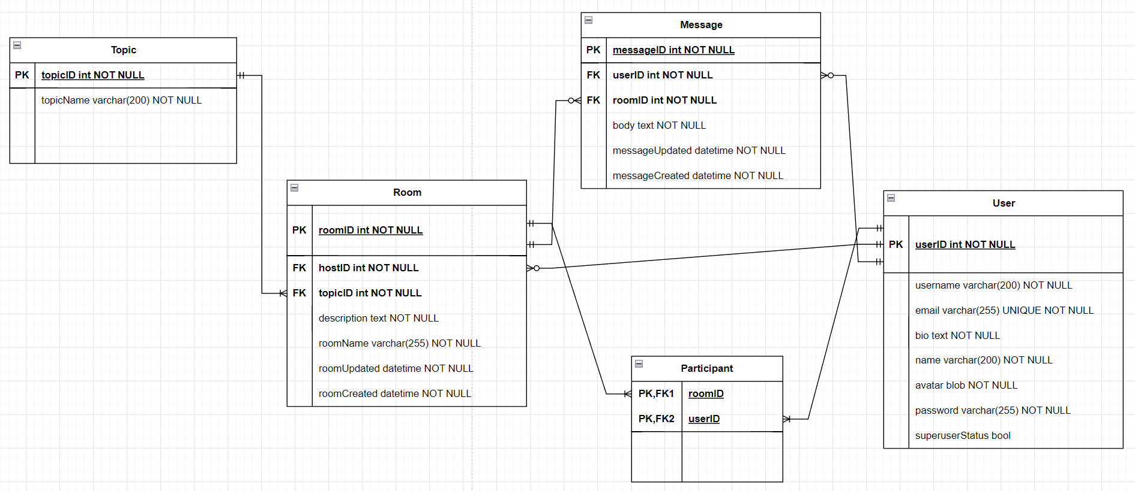
Entity Relationship Diagram

Slide 13
Future Plans

Slide 14
Future Plans
Ver 1.3 and beyond - (TBD)
Potential identity framework integration.
Adding “favorite genre”, “pronouns” and “spotlight link” (links to music profiles, websites, etc.) to custom user model.
More development on REST API.
Hooktheory chord builder and API integration (https://www.hooktheory.com/api/trends/docs).
Intended to be a separate portion of the website, but I would ideally like to add this to the posts/profiles as well.
Potential contact email for inquiries.
Copyright Investigation

Slide 15
Thank you!
Website: chordity.onrender.com
Source Code: github.com/rexherndon/chordity

